Slide 1
Centrality

Slide 2
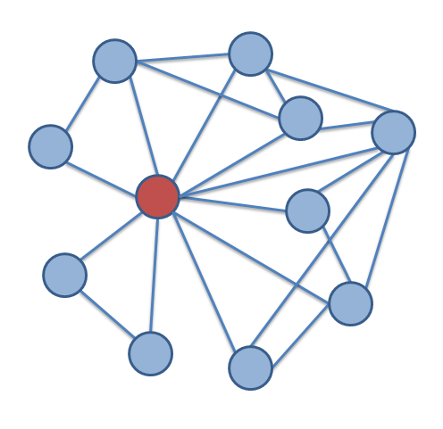
Centrality: What is it?
Central notion in network analysis
  However, ill-defined conceptually
  Intuitively, vertex-level index of prominence or importance
  Dozens and dozens of centrality have and continue to be proposed
Only agreement is that centrality is a vertex-level construct

Slide 3
Centrality: What is it?
Plethora of (sometimes inconsistent) substantive interpretations
  Autonomy
  Control
  Risk
  Exposure
  Influence
  Belongingness
  Brokerage
  Independence
  Power
  Strategic Location

Slide 4
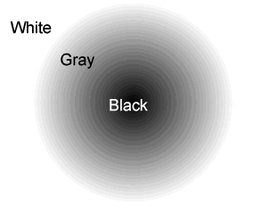
Centrality: A coherent or a fuzzy category?
Is there any criterion that is definitional of the notion of a centrality index?
Is there anything that all measures of centrality have in common?
Are there any structural properties of a vertex that are not a centrality measure?

Slide 5
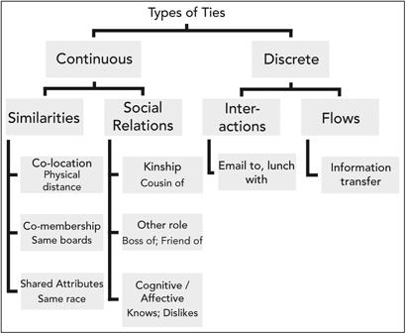
Centrality: Some conceptual issues
What Kind of Network do You have?
  The same measure means different things in networks defined by different kinds of ties
    Role relations (states)
      Friends, kin, business partners
    Interpersonal sentiments and cognitions
      Liking, trusting, acquaintanceship
    Behavioral social interactions
      Calling, texting, supporting, resource exchange
    Opportunity structure for exchange
      Structural holes, brokerage, intermediation (non-ties” matter here)

Slide 6
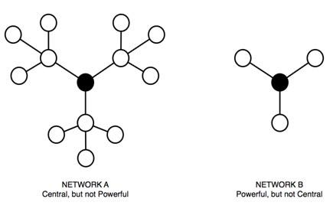
Centrality: Some conceptual issues
Acquaintanceship network: Being connected to connected others is good!
Restricted Exchange Network: Being connected to connected others is bad!

Slide 7
Centrality: Some conceptual issues
Acquaintanceship network: Being connected to connected others is good!
Restricted Exchange Network: Being connected to connected others is bad!

Slide 8
Centrality: From network concepts to measures
Some notion of prominence, importance, brokerage, being “in the middle of things,” being in a favorable exchange position, etc.
Translate the concept from natural language to the “language” of graph theory to develop a graph-theoretic concept
(e.g. points and lines)
Link the graph-theoretic concept to matrix algebra to develop a measure of the network-theoretic concept (e.g. matrix operations)
Result: A ranking of the nodes in the network
V₁
V₂
V₃
.
.
.
.
.
.
V_{n}

Slide 9

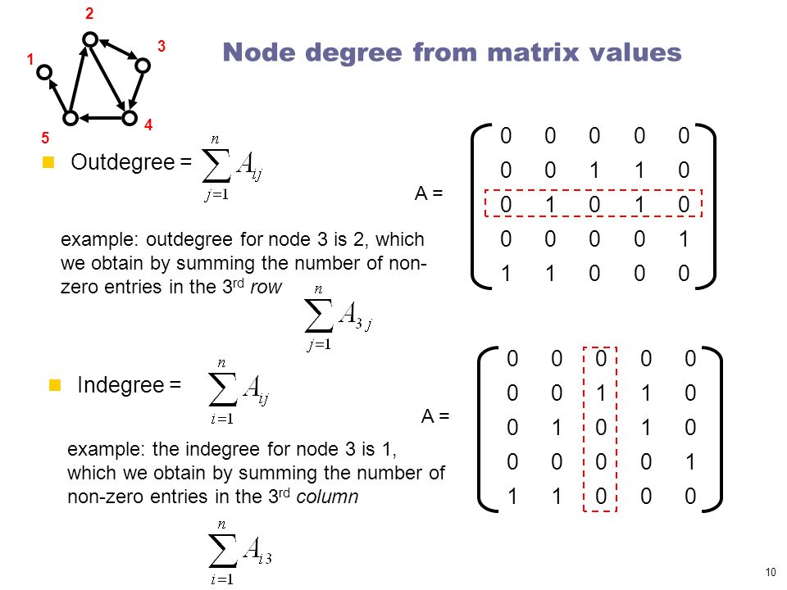
Degree C_{d}(v_{i})
Simplest (local) centrality measure to compute
  Most criterion and face validity
In undirected graphs:
  Given by the row or column sum vector of corresponding adjacency matrix
In directed graphs:
  Outdegree given by the row sum vector of corresponding adjacency matrix

Slide 10
Radial centralities: Degree C_{d}(v_{i})
Simplest (local) centrality measure to compute
  Most criterion and face validity
In undirected graphs:
  Given by the row or column sum vector of matrix
In directed graphs:
  Outdegree given by the row sum vector of matrix
  Indegree given by the column sum vector of matrix

Slide 11
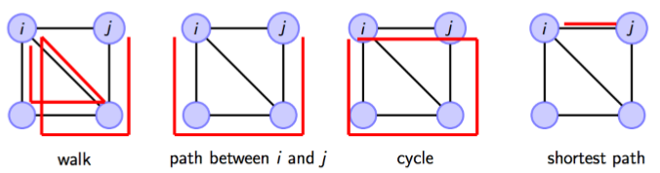
Walks and Paths (again)
A walk is an alternating sequence of vertices and edges {u₁, e₁₂, u₂, e₂₃, u₃...u_{m}, e_{mn}, u_{n}} starting with an origin vertex u₁ ending with a destination vertex u_{n} such that:
  There is an edge linking each successive vertex in the sequence (excluding the origin and destination vertices)
The length of the walk is the number of edges contained in the sequence
  A walk is called a path if all edges and all vertices appear only once in the sequence

Slide 12
Walks and Paths (again)
A walk is an alternating sequence of vertices and edges {u₁, e₁₂, u₂, e₂₃, u₃...u_{m}, e_{mn}, u_{n}} starting with an origin vertex u₁ ending with a destination vertex u_{n} such that:
  There is an edge linking each successive vertex in the sequence (excluding the origin and destination vertices)
The length of the walk is the number of edges contained in the sequence
  A cycle is a path the begins and ends with the same vertex

Slide 13
Walks and Paths (again)
A walk is an alternating sequence of vertices and edges {u₁, e₁₂, u₂, e₂₃, u₃...u_{m}, e_{mn}, u_{n}} starting with an origin vertex u₁ ending with a destination vertex u_{n} such that:
  There is an edge linking each successive vertex in the sequence (excluding the origin and destination vertices)
The length of the walk is the number of edges contained in the sequence
  A shortest path between two vertices is the path with the smallest length

Slide 14
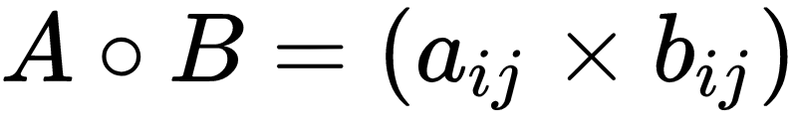
Matrix Operations: Matrix Multiplication
Matrices:
  Two-dimensional array of numbers: Row dimension and column dimension
Two kinds of matrix multiplication:
  Element-wise matrix multiplication, also known as the Hadamard product (￮)
    Only defined for matrices with the same row and column dimensions
  Matrix multiplication proper (✕)
    Only defined for conformable matrices
1 | 0 | 1
0 | 1 | 0
1 | 1 | 1
0 | 0 | 0
1 | 1 | 1
1 | 0 | 1
0 | 0 | 0
0 | 1 | 0
1 | 0 | 1
A _{3 x 3}
B _{3 x 3}
C_{3 x 3}

Slide 15
Matrix Operations: Matrix Multiplication
A_{4 x 2} ✕ B_{2 x 3}
A_{4 x 3} ✕ B_{2 x 3}
Inner dimensions
Inner dimensions
Outer dimensions
.
Outer dimensions
.
B _{2 x 3}
B _{2 x 3}
A _{4 x 3}
A _{4 x 2}

Slide 16
Matrix Operations: Matrix Multiplication
A_{4 x 2} ✕ B_{2 x 3}
A_{4 x 3} ✕ B_{2 x 3}
Inner dimensions match! Matrices are conformable
Inner dimensions don’t match! Matrices are not conformable
Inner dimensions
Inner dimensions
Outer dimensions
.
Outer dimensions
.
B _{2 x 3}
B _{2 x 3}
A _{4 x 3}
A _{4 x 2}

Slide 17


Matrix Operations: Matrix Multiplication
A_{4 x 2} ✕ B_{2 x 3}
A_{4 x 3} ✕ B_{2 x 3}
Inner dimensions match! Matrices are conformable
Inner dimensions don’t match! Matrices are not conformable
Inner dimensions
Inner dimensions
Outer dimensions
.
Outer dimensions
.
B _{2 x 3}
B _{2 x 3}
A _{4 x 3}
A _{4 x 2}

Slide 18
Matrix Operations: Matrix Multiplication
A_{4 x 2} ✕ B_{2 x 3}
A_{4 x 3} ✕ B_{2 x 3}
Inner dimensions match! Matrices are conformable
Inner dimensions don’t match! Matrices are not conformable
Inner dimensions
Inner dimensions
Outer dimensions
.
Outer dimensions
.
In general you can multiply any A_{m x n} matrix ✕ any B _{q x p} matrix:
  So long as n = q
  It doesn’t matter what the values of the outer dimensions is

Slide 19
Matrix Operations: Matrix Multiplication
A_{3 x 2} ✕ B_{2 x 4} = C_{3 x 4}
A_{3 x 2} ✕ B_{3 x 4} = Not defined
Inner dimensions
Inner dimensions
Product matrix C is 3 X 4 same as the outer dimensions
Outer dimensions
.
Outer dimensions
.
The outer dimensions determine the dimensions of the resulting matrix such that A_{m x n} ✕ B _{q x p} = C _{m x p}

Slide 20
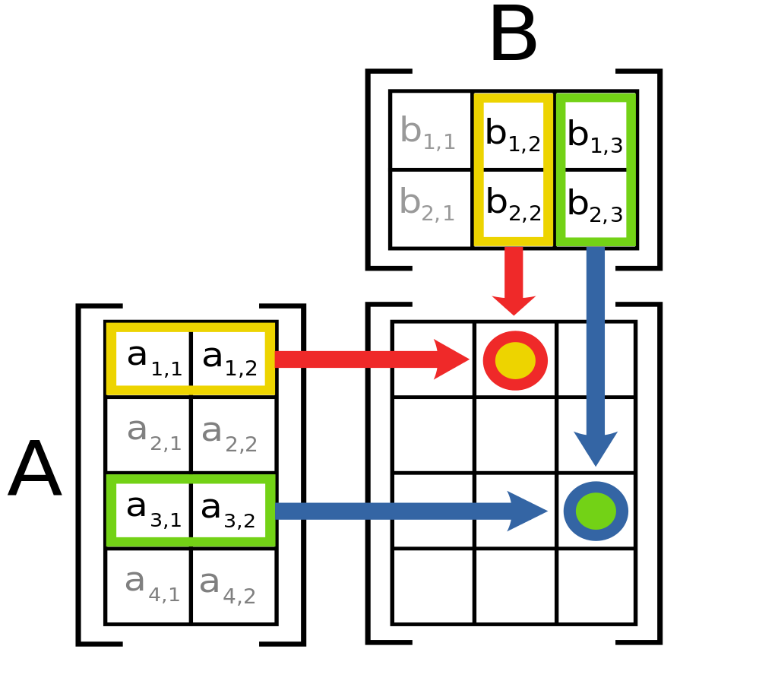
Matrix Operations: Matrix Multiplication
a | b
c | d
e | f
g | h
=
a * e + b * g | a * f + b * h
c * e + d * g | d * f + d * h
X
2 x 2
2 x 2
2 x 2
How does it work?
For A X B:
  The ij cell of the resulting matrix is given by the sum of the product of the corresponding cells of row i in A and column j of B

Slide 21
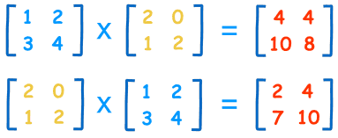
Matrix Operations: Matrix Multiplication
a | b
c | d
e | f
g | h
=
a * e + b * g | a * f + b * h
c * e + d * g | d * f + d * h
X
2 x 2
2 x 2
2 x 2

Slide 22
Matrix Operations: Matrix Multiplication
a | b
c | d
e | f
g | h
=
a * e + b * g | a * f + b * h
c * e + d * g | d * f + d * h
X
2 x 2
2 x 2
2 x 2
C₁₁ = (1 * 2) + (2 * 1) = 4
A
B
C

Slide 23
Matrix Operations: Matrix Multiplication
a | b
c | d
e | f
g | h
=
a * e + b * g | a * f + b * h
c * e + d * g | d * f + d * h
X
2 x 2
2 x 2
2 x 2
C₂₁ = (3 * 2) + (4 * 1) = 10
A
B
C

Slide 24
Matrix Operations: Matrix Multiplication
Properties of matrix multiplication:
  Not commutative!
    A X B ≠ B X A
    A X B can be defined but the reverse is no the case
  Associative:
    (A X B) X C = A X (B X C)
  Distributive over addition:
    A X (B + C) = (A X B) + (A X C)

Slide 25
Matrix Operations: Matrix Multiplication
Properties of matrix multiplication:
  Square matrices of the same dimension can always be multiplied
  A square matrix is one in which the row and column dimensions are of the same size
  Network adjacency matrices are square matrices
  You can take matrix powers by self-multiplication:
    A² = A X A
    A³ = A X A X A
    A^{k} = A X A X A ....(k times)

Slide 26

Matrix operations: Powers
Why do we care about matrix multiplication?
  If we represent a graph using adjacency matrix A
  Taking n^{th} power of the adjacency matrix gives us the number of paths of length n connecting each vertex to one another
  This is the basis of most “path-length” measures of centrality

Slide 27
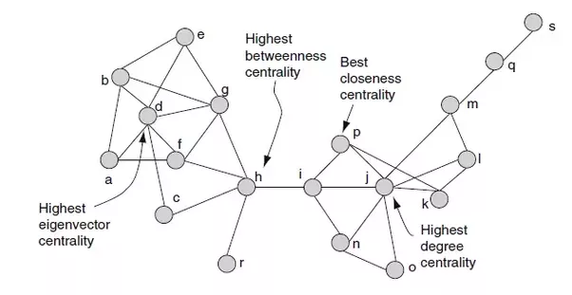
A typology of centrality measures
Centrality measures appear to cluster around some key dimensions
What they all have in common is that:
  They all somehow index the importance of the vertex in the walk structure of the network
  Computation is based on a matrix of pairwise reachability between all vertices in a graph

Slide 28
A typology of centrality measures
Centrality measures appear to cluster around some key dimensions
A vertex is central insofar as a lot of walks of a certain type either:
  Feature that node as their origin or endpoint
    These are "radial" measures (e.g. degree)
  Contain that node in the walk sequence
    These are "medial" measures (e.g. betweenness)

Slide 29
A typology of centrality measures
Within the radial and medial categories we may distinguish centralities measures that either:
  Restrict the type of walk to be considered
    Shortest paths
    k-paths
    Edge(vertex)-disjoint
  Do not restrict the type of walk to be considered

Slide 30
A typology of centrality measures
Finally, we can distinguish measures depending on whether we are interested in either
  The number of walks of a certain type that either originate or contain a vertex (volume)
  Or the size of walks of a certain type that either originate in or contain a vertex (length)

Slide 31
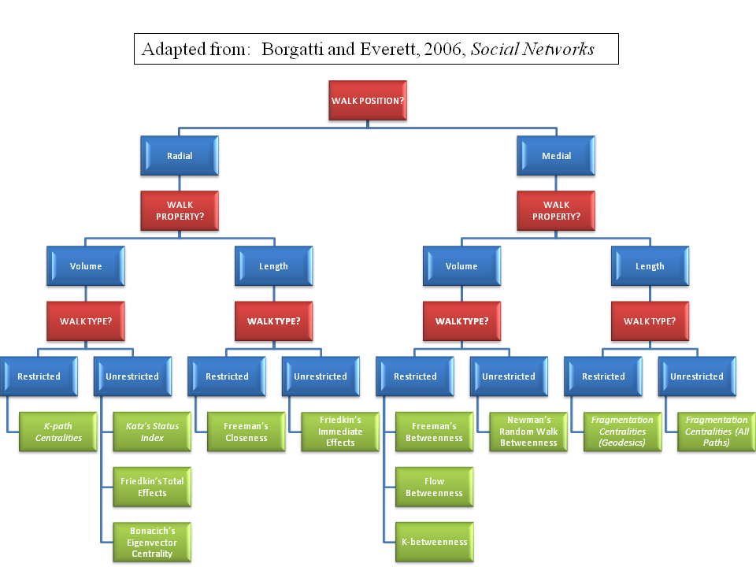

Slide 32
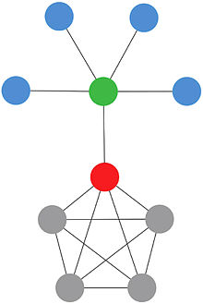
Radial centralities: K-path centrality C_{k-path}(v_{i})
First proposed by Sade (1989)
  Social Network Concept: How many people is a person indirectly connected to?
  Graph theoretic concept: Sum of all paths of length k that have vertex v_{i} as their first element
  Matrix Procedure: Take the row sum of matrix W, where W_{ij} is the number of paths of length k from i to j
Can be thought of as a generalization of degree centrality
  Degree centrality = 1-path centrality, since all entries in the adjacency matrix indicate a path of length 1 from i to j

Slide 33
Closeness centrality C_{close}(v_{i})
First proposed by Sabidussi (1966)
  Social Network Concept: How many other people can a given person easily reach if they wanted to?
  Graph theoretic concept: Given by the Reciprocal of the sum of of the number of shortest paths that originate in v_{i} and end in all other vertices
  Matrix Procedure: Take the reciprocal of the row sum of matrix W, where W_{ij} is the number of shortest paths from i to j

Slide 34
Medial centralities: Betweenness C_{between}(v_{i})
First proposed by Freeman (1977)
  Social Network Concept: What share of the entire network flow goes through a given person?
  Graph theoretic concept: Sum of of the proportion of shortest paths in the graph between all other pairs of vertices {v_{j}, v_{k}} that contain v_{i}
Defined for both connected and unconnected graphs

Slide 35
Radial centralities: Eigenvector C_{eigen}(v_{i})
First proposed by Bonacich (1972)
  Social Network Concept: Somebody is central if they are connected to central people
  Matrix Procedure: Factorize the adjacency matrix A using the Singular Value Decomposition (SVD):
    A = UWV
    Generate vector u from the first column of the matrix U
    Create a new matrix (W) where
    Wij = Aij x Uj
    C_{Eigenvector}(v_{i}) = Row sums of W

Slide 36
Radial centralities: Eigenvector C_{eigen}(v_{i})
Acquaintanceship network: C_{eigen} gives the right answer
Restricted Exchange Network: C_{eigen} gives the wrong answer (right answer: C_{eigen} * -1)

